Slide 1
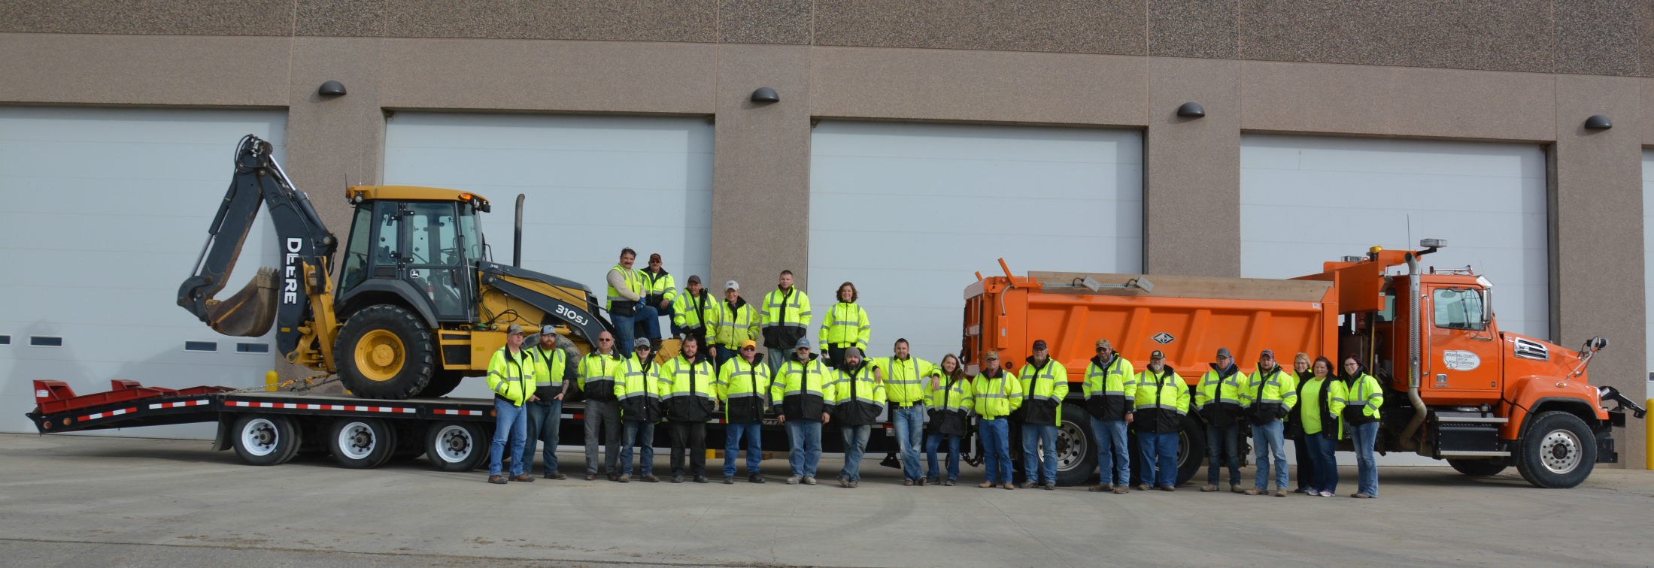

MOUNTRAIL COUNTY
CDL TRAINING PROGRAM

Slide 2

My name is Jana Hennessy,
and I proudly serve the public of Mountrail County as the County Engineer, a role I’ve held since 2013.
Janah@co.mountrail.nd.us
701-629-5609

Slide 3
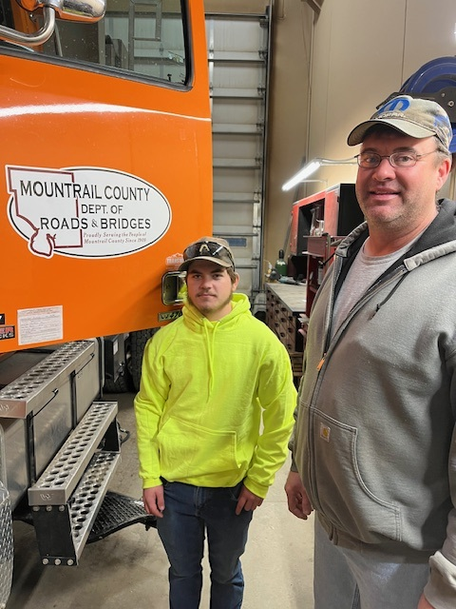
MOUNTRAIL COUNTY CDL TRAINING PROGRAM
FORMAN / FMCSA CERTIFIED CDL TRAINER
Nathan Story
NEW HIRE / CDL TRAINEE
Wyatt Hanson

Slide 4
FEDERAL CDL REQUIREMENT CHANGES
In December 2016, the Federal Motor Carrier Safety Administration (FMCSA) issued a final rule establishing national minimum training standards for new (entry-level) truck and bus drivers.
These training requirements became mandatory on February 7, 2022.
Training must be done through providers on the FMCSA’s Training Provider Registry (TPR).

Slide 5




Truck Driving School Program
Duration: 3+ weeks
Cost: $6,000 – $7,000

Slide 6
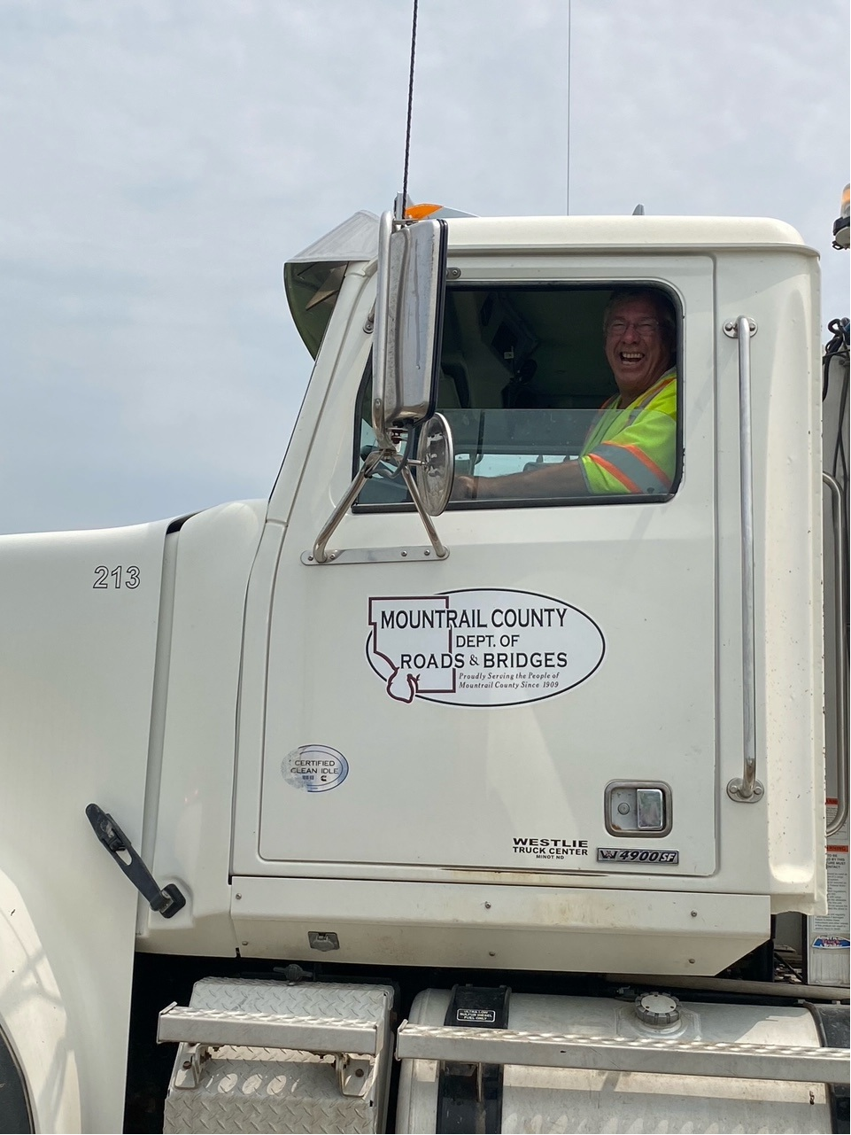
WHY IS CDL IMPORTANT
Fully Capable Employees
Increases workforce flexibility –
any employee can step into
driving roles when needed
Independent Operations
Graveling
Dust control application
Snow removal
Hauling material or equipment
Emergency Response
During storm, floods, or accidents
Cost Efficiency

Slide 7
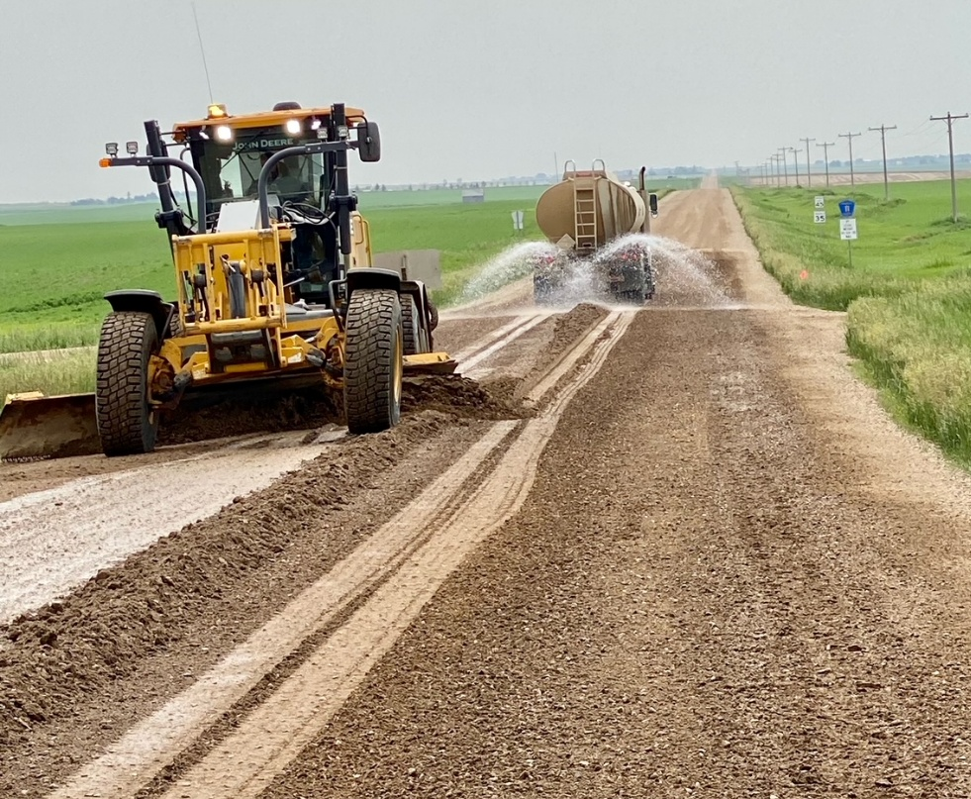
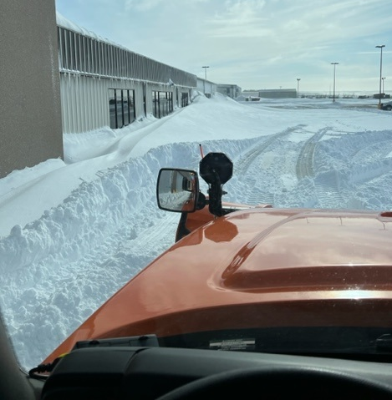
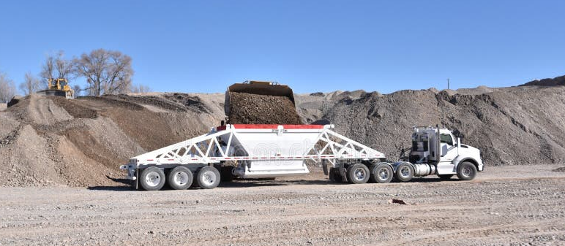

Slide 8
OUR CDL TRAINING PROGRAM SETUP
1. Follow FMCSA Requirements
Use the federal FMCSA Entry-Level Driver Training (ELDT) standards as the foundation.
Ensure all curriculum elements meet federal standard.
2. Create FMCSA Training Provider Account
Register the County as a Training Provider in the FMCSA Training Provider Registry (TPR).
Set up administrator access for designated staff.
3. Self-Certify Trainers
Identify qualified in-house personnel.
Self-certify them in the TPR system as skills or theory instructors.
Maintain proof of qualifications.
4. Complete Required Background Checks
Conduct and document background checks for each trainer.
Retain verification for compliance audits.
5. Document All Training Activities
Keep records of curriculum, attendance, range/road skill evaluations, and test results.
Maintain files in accordance with FMCSA standards.
6. Submit Completion Data to FMCSA
Electronically submit student completion information to the TPR.
Ensure data is timely and accurate to allow CDL testing.

Slide 9
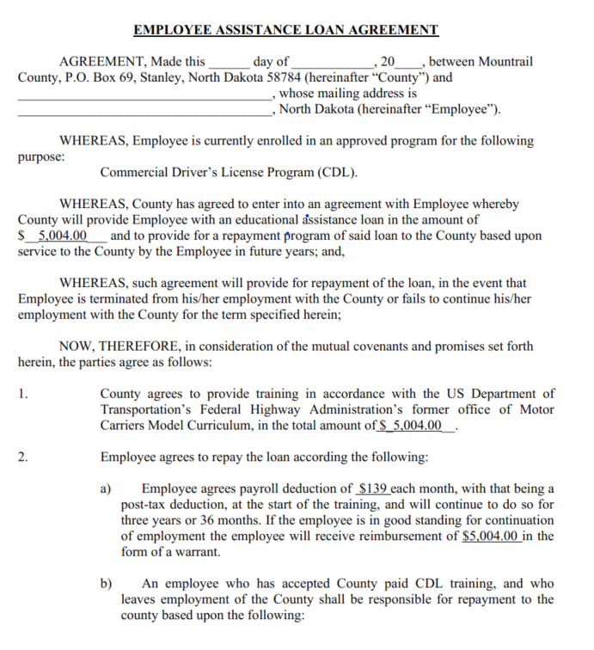
EMPLOYEE ASSISTANCE LOAN AGREEMENT
Program Cost = $5,000
($139/month payroll deduction over 36 months)
In 3 years, the employee will receive $5,000 back

Slide 10
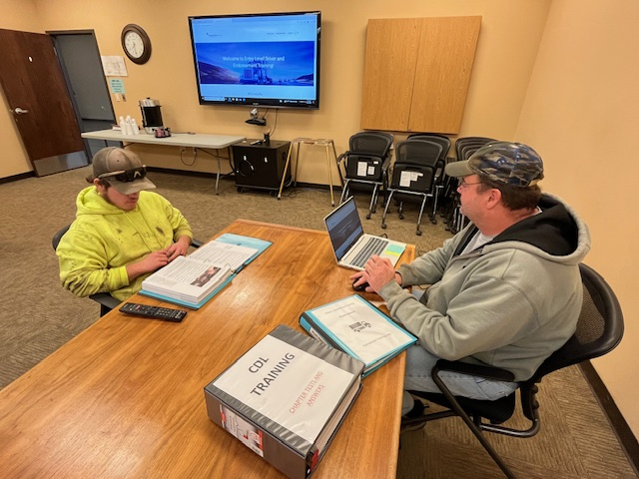
CDL TRAINING PROGRAM

Slide 11
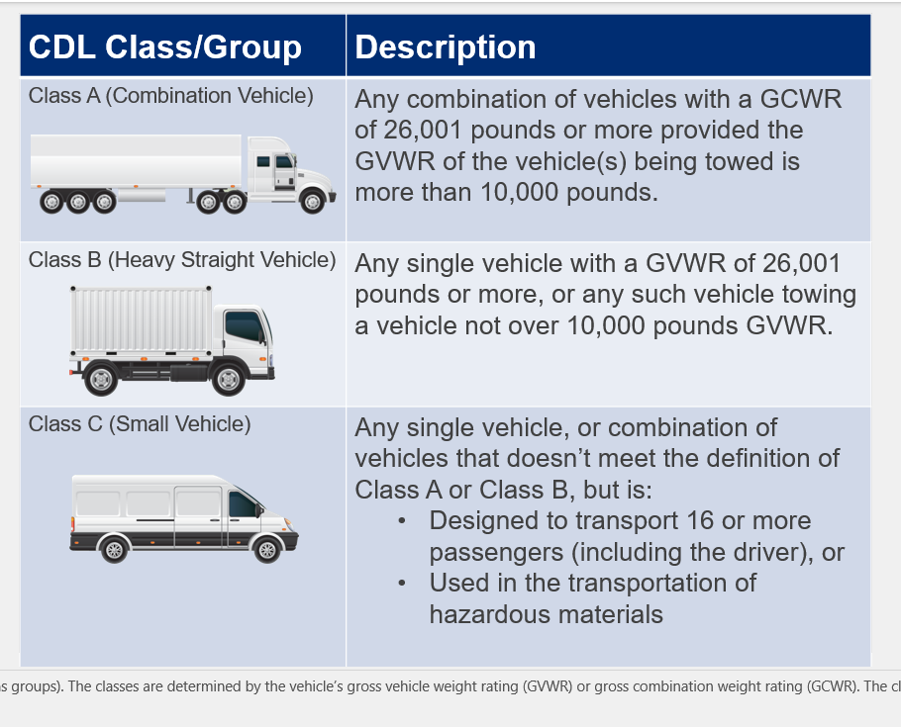
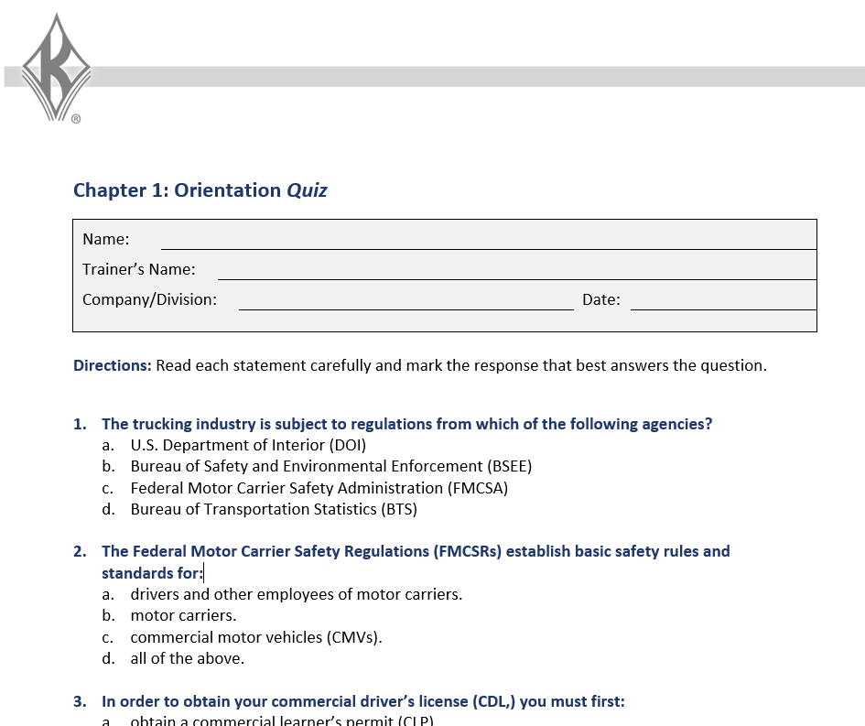
CDL TRAINING MATERIAL J.J. Keller & Associates, Inc.
POWER POINT
QUIZ

Slide 12
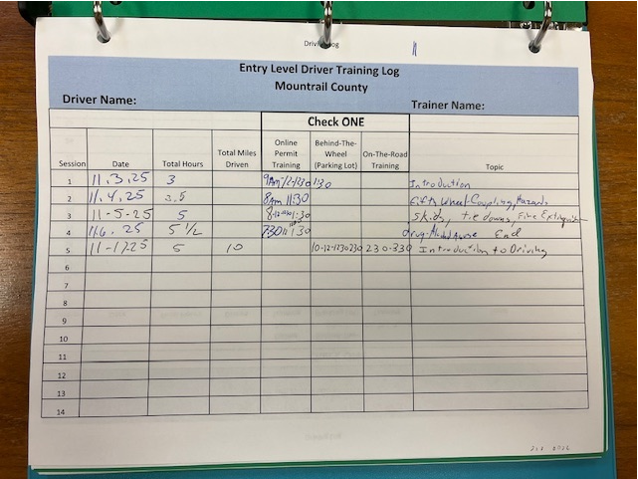
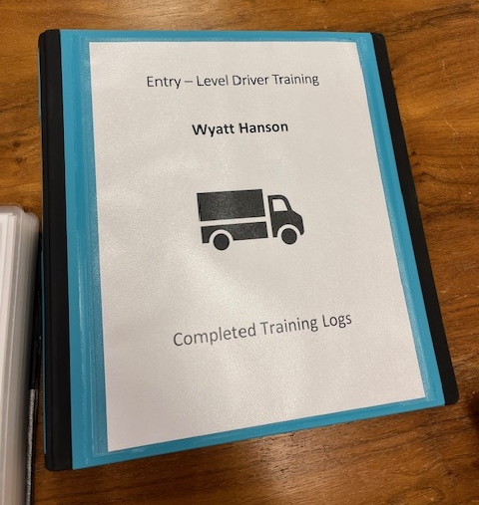
CDL TRAINING MATERIAL

Slide 13
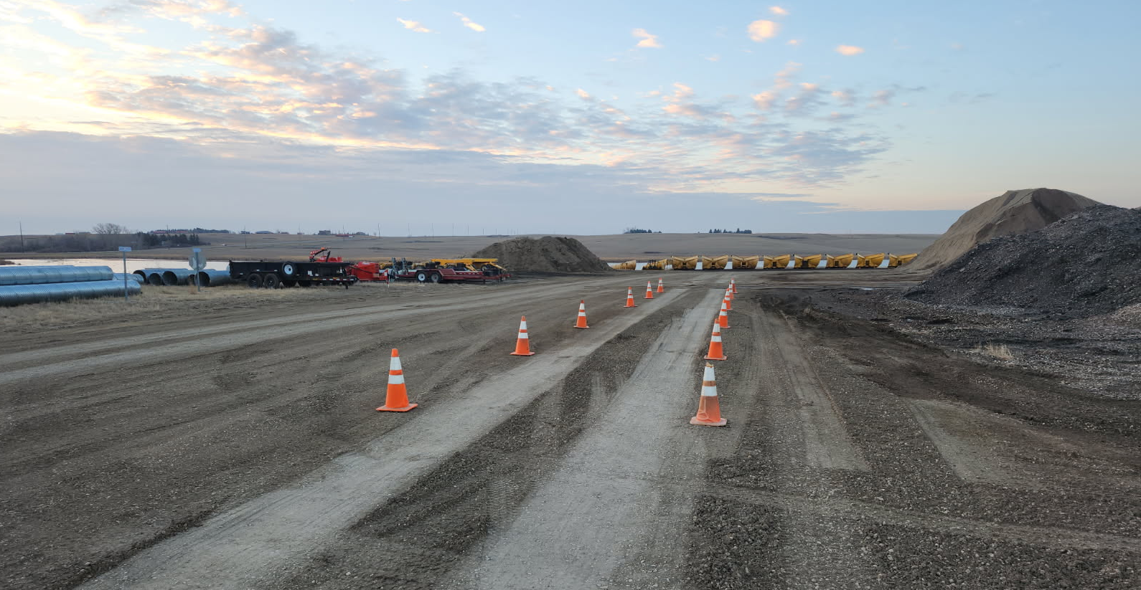
ON-SITE TRAINING SETUP

Slide 14
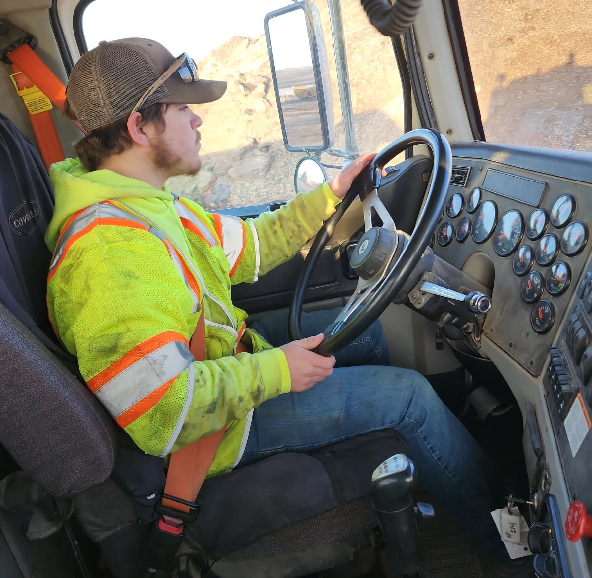
TRAINING ON THE JOB

Slide 15
PROS OF AN IN-HOUSE CDL TRAINING PROGRAM
On-the-job training
No lost production time
No up-front cost to employees
Affordable payroll deduction
County-led training = Quality & Consistency
Reimbursement in 3 years
Time to grow & appreciate the job
High retention & workforce stability

Slide 16

CONS OF AN IN-HOUSE CDL TRAINING PROGRAM
Community Benefit — Even If They Leave Whether they remain here or move on to another county, city, or private employer, we still contribute trained, qualified CDL operators to serve North Dakota.

Slide 17
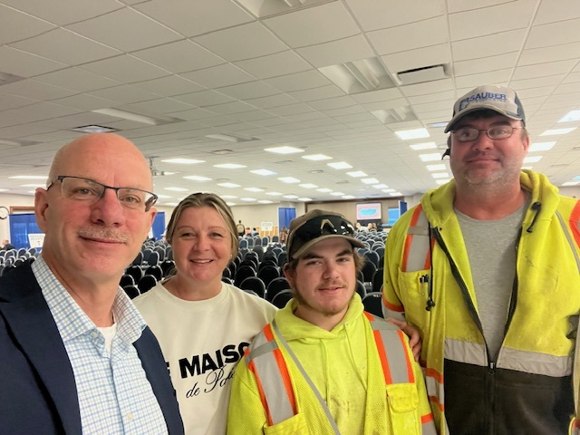

Pat Bertagnolli, Executive Director Job Service North Dakota

Slide 18


