Slide 1

HB 1176: lessons learned
Linda Svihovec, NDACo
Cell: (701) 570-0082
Email: linda.svihovec@ndaco.org

Slide 2
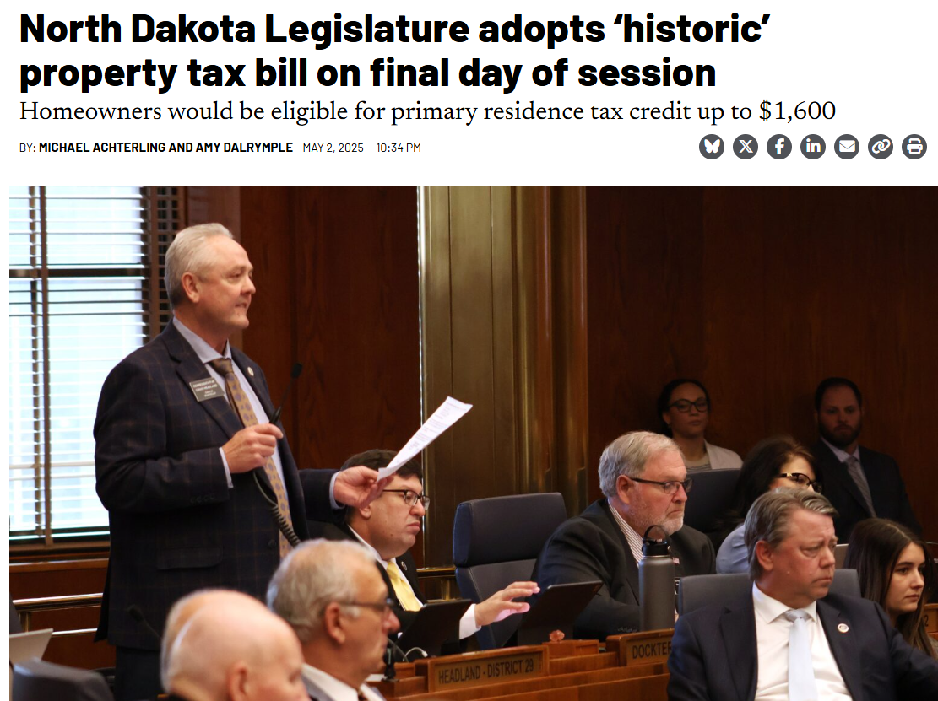
HB 1176: Property Tax Relief & Caps for Local Government
RELIEF:
$1600 tax credit for Primary Residences (PRC)
$403 million / biennium – uses Legacy Fund Earnings
Effective Immediately for 2025 tax year
PRC cannot:
Reduce Liability for special assessments
Exceed the amount due on primary residence
Increases Renter Refund to $600
Increases Disabled Veteran’s Credit
No Expansion of Homestead Tax Credit over current eligibility
Applied after other Credits

Slide 3
HB 1176: Property Tax Relief & Caps for Local Government
LIMITATIONS:
Effective for 2025
CAPS Local Government at 3% growth in dollars levied
Can not exceed: greater of either - base year levy increase by 3% or adjusted year levy increase
Political Subdivisions can carry over unused percentage one time within 5 years
Counties, Cities & Schools allowed to vote to exceed 3% cap in General Election
Vote good for 4 years, indicate the percentage increase & proposed dollar amount increase (majority vote)
If ZERO mill authority - allowed to exceed 3% CAP if levy has not previously been used
CAP does not apply to:
Taxes levied to pay the principal & interest on obligations
Taxes levied to pay bonds, obligations or evidences of indebtedness issued by BND from infrastructure revolving loan fund
Emergency Fund levies
Taxes levied to pay special assessments; taxes levied for water resource districts
New or increased levy authority approved by the electors of the taxing district

Slide 4
HB 1176: Property Tax Relief &
Caps for Local Government
ADMINISTRATION:
Creates new property classification for primary residential property (2026)
Assessment Notices to all property owners (2026)
Includes: current & prior year true & full value
Date, time, location for local Board of Equalization meeting
Estimated Tax Notices Eliminated (2025)
Budget Hearing Notices - replaces estimated tax notices (2025)
Includes: date, time, location of public budget hearing for each of the taxing districts & where each taxing district’s budget is available for review
Political subs to provide info to county auditor by August 10th
Mailed or Emailed by August 31
Tax Statements to now include:
Amount of property tax levied as result of mills levied by school district
Identify PRC provided to taxpayer for each year
Specify PRC is derived from legacy fund
PRC can be applied to Voter-Approved Levies
Interim Study:
Implementation of HB 1176
Impact of levy limitations
Feasibility of revising tax statement
Analysis of tax-exempt property

Slide 5
HB1176 IMPACTS SurveY Scope & Participation
Survey sent to County Auditors/Finance Directors and Commissioners
15 Questions related to the 2026 Budget
56 Responses from 47 counties (including 12 Commissioners)

Slide 6
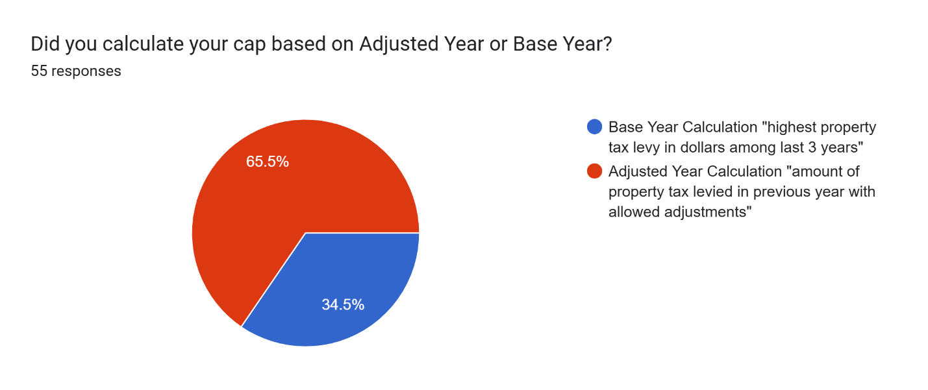
Operational Impacts use of reserves
Notes:
“Base Year”: highest dollar levied in last 3 years
“Adjusted Year”: prior year plus adjustments (new growth, etc)

Slide 7
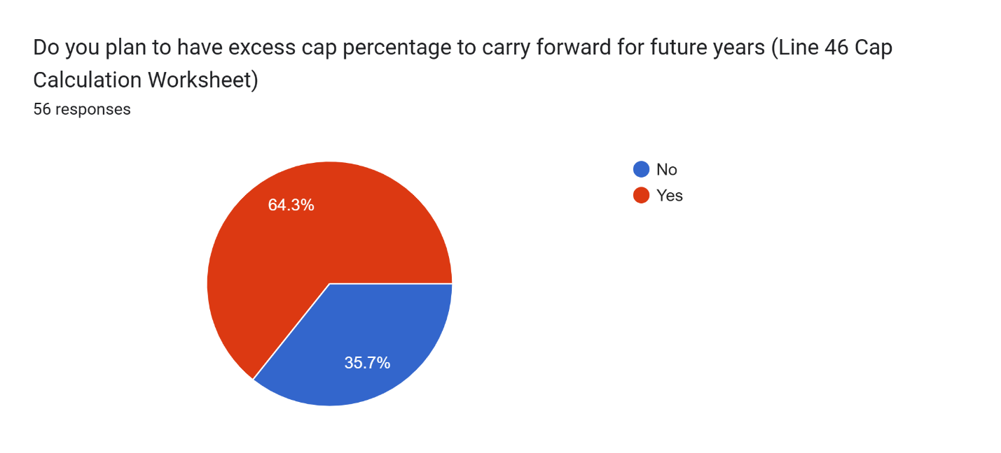
Operational Impacts use of reserves
Notes:
3% cap allowance ranged from $18,000 in Slope County to $1.8 Million in Cass County

Slide 8
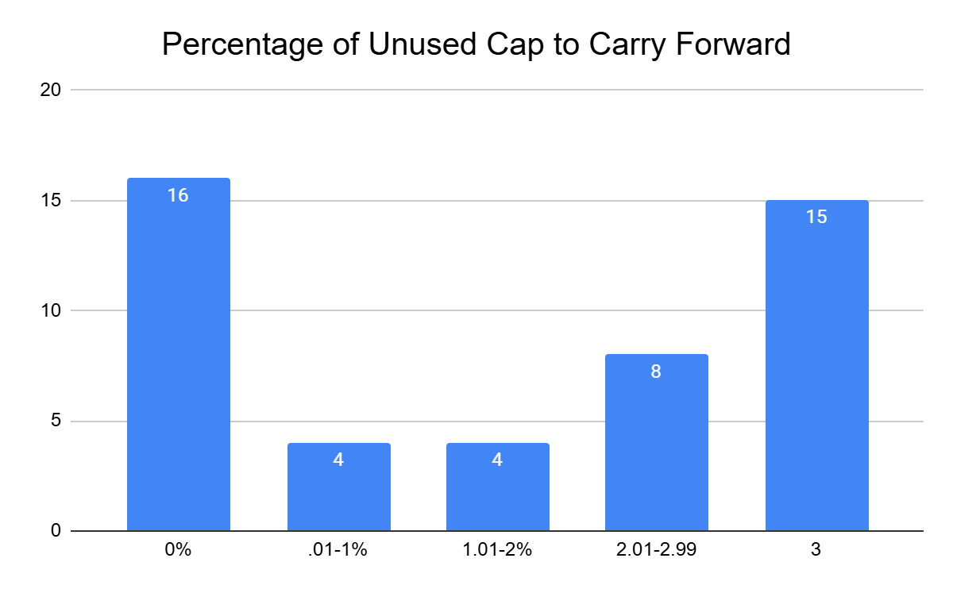
Amount of cap percentage to carry forward
Notes:
HB1176 allows taxing district to carry forward unused percentages of the 3% cap for up to 5 years. In 2025, 30 Counties approved budgets that will carry over a percentage of unused cap.

Slide 9
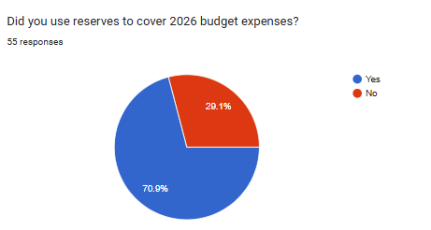
Operational Impacts use of reserves
Notes:
Diving further into this data we learned:
30 counties had an unused cap percentage to carry forward.
Of those 30 counties, 20 of them used RESERVES to fund their 2026 budgets.
12 counties spent down reserves and used all of the cap allowance dollars (no excess cap to carry over).

Slide 10
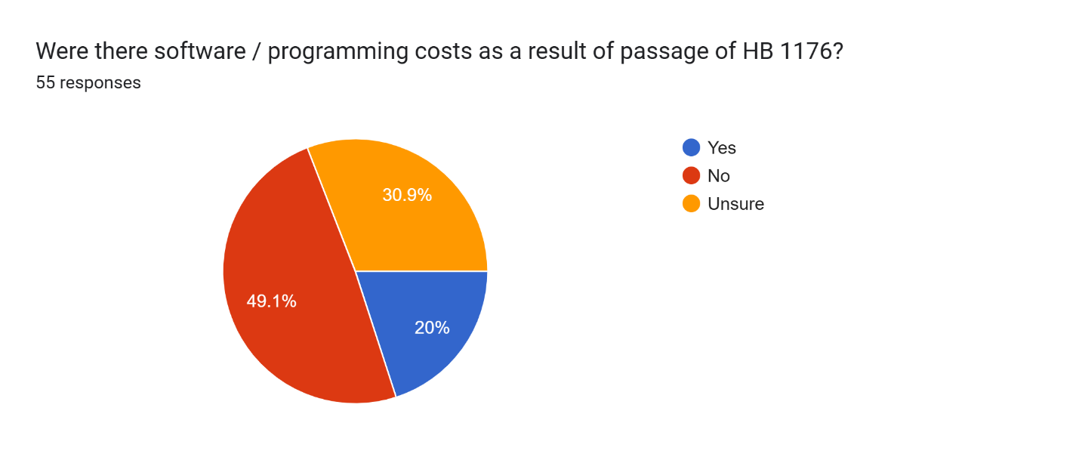
Operational Impacts programming costs
Notes:
Other Financial Impacts Associated with HB 1176
Election costs alone totals over $3 million statewide ranging from $4,300 in Renville County to $571,000 in Cass County.
Software and programming changes that were required to meet the legislative requirements in HB 1176.
Limited ability for counties to obtain state grants (Township Roads, State Library Aid, Weed Board State Grant)

Slide 11
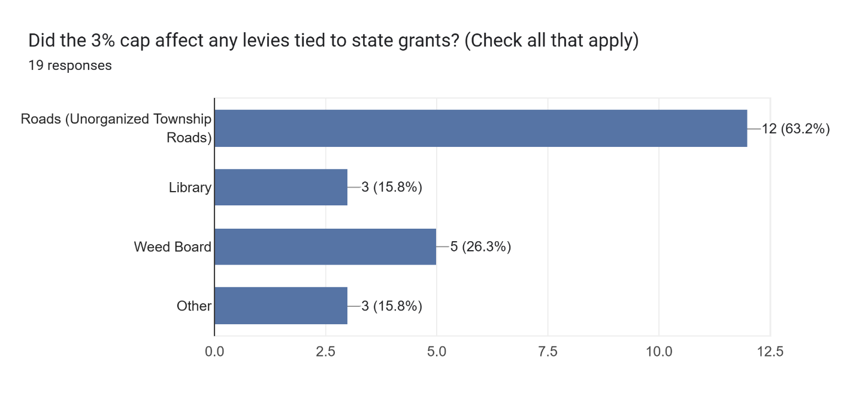
Operational Impacts state grants

Slide 12
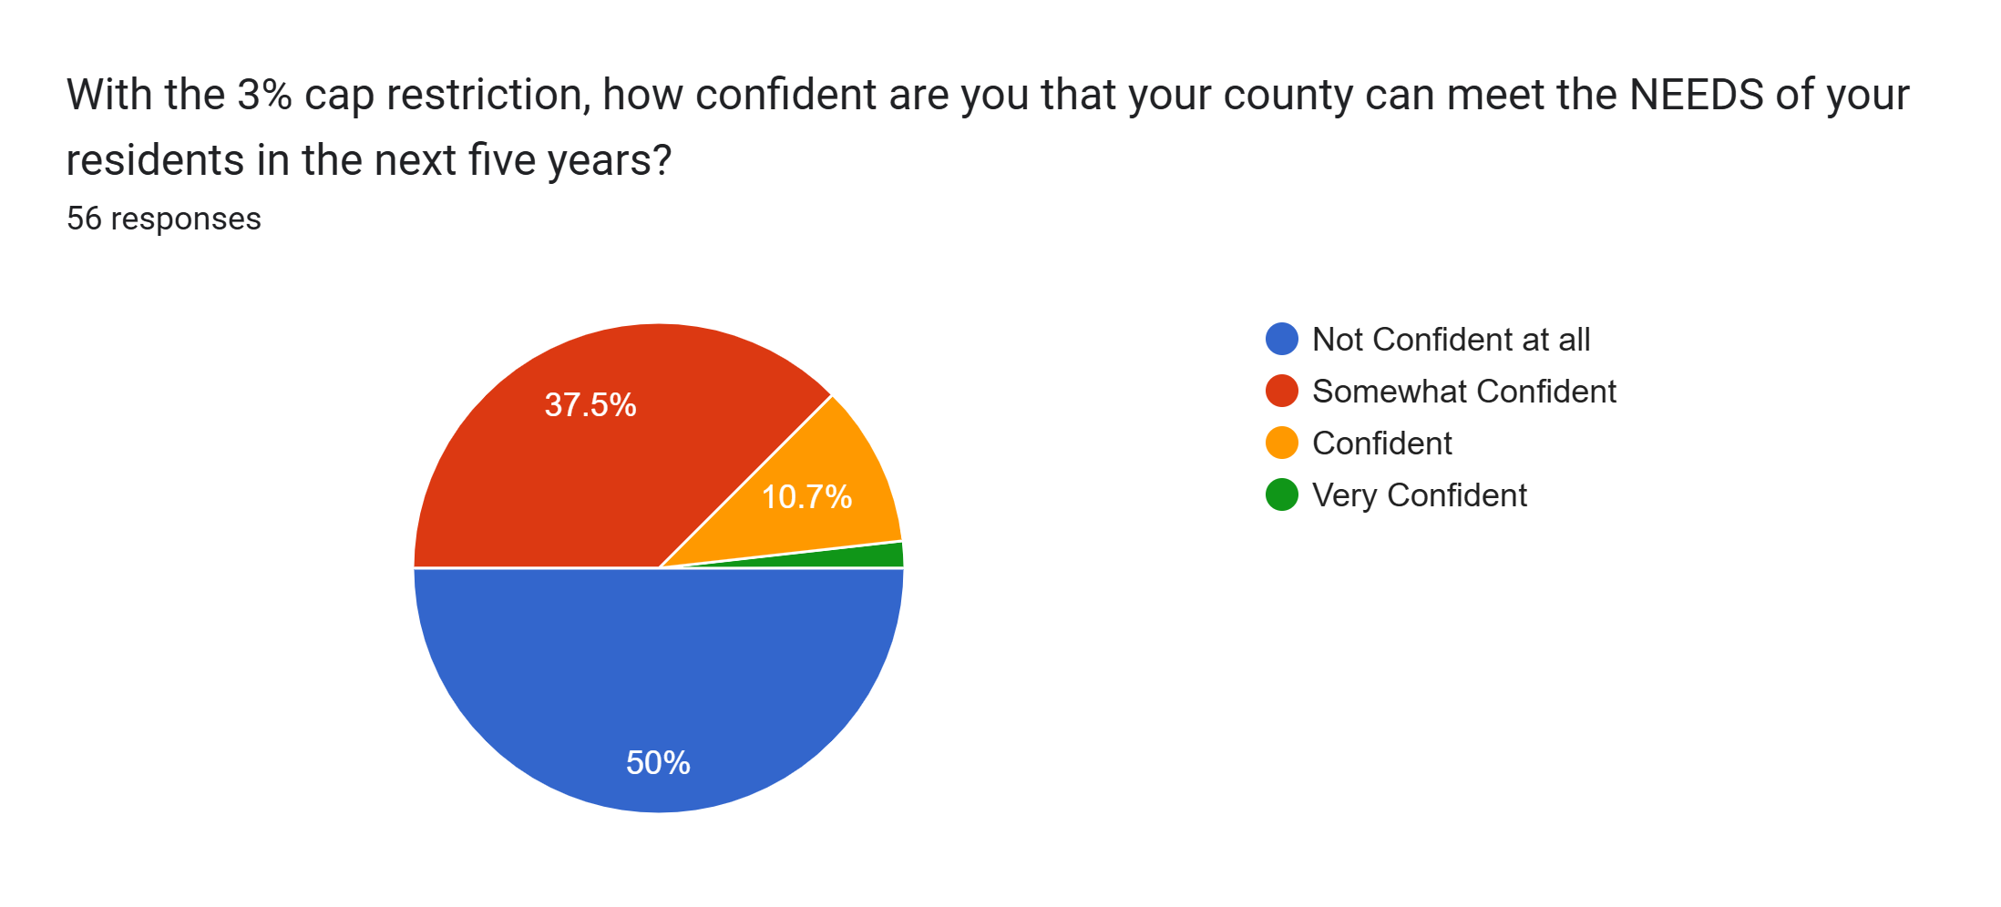
Confidence in meeting residents needs
Notes:
Nearly 90% of respondents say they are NOT CONFIDENT AT ALL or SOMEWHAT CONFIDENT that under the 3% Cap environment the county can meet the NEEDS of residents in the next 5 years.

Slide 13
Looking Forward
Top items Counties indicated they have cut due to the budget limitations:
Salary increases
Road projects
Law enforcement
Delayed equipment purchases
Counties shared the following key concerns:
Overarching comments about a deep concern for the future
Expansion of exemptions for items like elections, health care costs, corrections and other unfunded state mandates or costs counties can not control
Cap needs to be adjusted upward to 5% or tied to inflation
Depleting reserves in order to fill gap in funding is unsustainable
Inability to provide adequate / competitive salary increases
Inability to keep up with the cost to maintain or repair county buildings
Notes:
Describe the challenges your county endured in meeting the legislative requirement of a 3% cap.
If the Legislature continues to support a cap in future sessions, what other tweaks or changes do you see necessary?

Slide 14


QUESTIONS??
Linda Svihovec
NDACo, Research Analyst
Cell: (701) 570-0082
Email: linda.svihovec@ndaco.org

