Slide 1
Tool Chest for Local Government

Slide 2
Topics
History – The Why
Options – The What
Process – The How
Results – The Who

Slide 3
Introduction
Excerpt from NDCC section 1 of HB1347 (1993)
North Dakota communities face an uncertain future, within an environment of diverse economic, social, and demographic circumstances. Each community is subject to a unique interplay of these critical circumstances…
There is a common need for addressing the future of local governance by permitting and encouraging local citizens and leaders to initiate study, cooperation, and adaptation in local governance in recognition of the diverse circumstances and resources of North Dakota communities…
Notes:
Too often when we use the term “tool Chest” we are referring to one, important, but pretty small piece of a 100 plus page bill that enacted or reenacted 53 sections of Century Code, while also repealing 30 sections of existing law governing local government authority and limitations on that authority.
This omnibus bill begins with: (Read the slide) This is a huge recognition of the diversity among local governments. Too often even now, but certainly before the 1990’s, the legislature acted as if all counties, all cities, and townships were alike, and they could “fix” a problem with a statute.
We have to remember that the Tool Chest came on the heals of a serious downturn in the state’s economic situation. Oil projection had been dropping steadily for more than a decade, ag income was down by almost 25% from 10 years before, state tax revenues were stretched. So, the legislature, struggling with their budget, naturally looked at making local government more cost-effective. This was at the time of the very first (unsuccessful) “SuperCounty Bill” . SB2325 proposed collapsing 53 counties into 15 multi-county districts with one board of commissioners, and one set of elected and appointed officials. It was claimed that local governing boards were unwilling to consider shared services, cooperative efforts and consolidation. So the legislature had to do that for them – starting with the counties.

Slide 4
History
Dillon’s Rule
Joint Powers
Home Rule
Notes:
Dillon’s Rule
I put this in as a reference to what nationally our historical structure of county government is termed. It refers to court opinion written by Iowa Supreme Court Justice John Dillon that says.
Local government only exercises
(1) powers expressly granted by the state,
(2) powers necessarily and fairly implied from the grant of power, and
(3) powers crucial to the existence of local government.
Effectively the opposite of the Federal state relationships that says whatever isn’t reserved for the federal government is state.
So historically, the structure of counties at least was that county boards and county voters weren’t permitted to make changes on how they were structured, funded, or the services they delivered.
Counties were granted the ability to enter into joint powers agreements with other counties, as well as cities, townships and other local governments. While initially fairly broad, subsequent legislatures added very specific instances where JPAs could be used, to the point where the court determined that they could ONLY be used in those specific circumstances.
Similarly, there was hope that counties would be given greater latitude when they were granted Home Rule Authority in 1985, A city home rule court case Litten v. City of Fargo, successive legislation and most specifically a 1989 Attorney General opinion greatly limited what could be accomplished through home rule for counties. The AG concluded “Thus, it appears that the decision in Litten would be applicable to a home rule county under existing statutory language and would prohibit a home rule county from determining the structure or form of its county government. “
So, the Legislature in 1993 was wrong and right. It wasn’t that counties weren't;’t interested in structural change, it was just impossible to accomplish within the legislative restrictions.

Slide 5
Tool Chest Players
County Commissioners Association Resolution 1992 VI-1
Advisory Commission on Intergovernmental Relations (ACIR)
North Dakota Consensus Council
Notes:
Recognizing the local desire for greater flexibility and the pressures of the Legislature the County Commissioners passed a resolution supporting the development of options for greater local control. The hybrid legislative/local government ACIR had an interim study of the topic and endorsed this concept, and the ND Consensus Council received a grant to empanel a working group to iron out the details. This working group had county, city and township officials, legislators and legal council.

Slide 6
Tool Chest Contents
Joint Powers Authority broadened – anything one can do, all can do
County-city home rule allowed
Multi-county home rule
Co. manager governance - lower vote requirement
Other political subs transfer responsibilities to county
Multi-county elective office
Consolidation, separation,& redesignation of statutory county offices (11-10.2)
Advisory study process for counties and cities
Plus, many changes for city, township & park districts
Notes:
As I said, the result was a huge piece of legislation, generally broadening and simplifying joint powers and home rule provisions – repealing many of the specific instances. But for counties and cities it created (what was once) a mandatory every 5 year study process of their structure. This was changed to an optional process that can be initiated by the board or the citizens. And specifically for counties, it created a way that a county board or the citizens could initiate structural changes to county government – that part that is often thought of when we say Tool Chest.

Slide 7
Home Rule - Powers
YES
Sales Tax
Levy Consolidation/Limits
Ordinance Authority
Expenditure beyond state law
County Structure (except commission & sheriff)
NO
Income, gas, other taxes
Property tax classification
New crimes or penalties for state law violations
Regulate business already regulated by the state
Election administration
Notes:
Sales tax but no other taxes – this may need revisiting
Levy consolidation and levy limits but not tax classification and assessment
Ordinance authority – like recent ATVs, Dogs, Tobacco taxes, but not crimes and penalties\
Expenditures beyond state law (Dillon discussion) but can’t regulate business regulated by state
County structure (appoint consolidate, combine_ but can’t change how elections are conducted
CONSULT YOUR STATE”S ATTORNEY

Slide 8
11-10.2 Consolidation, separation, redesignation
YES
Combine statutory offices
Separate offices statutorily combined (Clerk/Recorder)
Redesignate elected offices as appointed
BUT
Commission and Sheriff are constitutionally created and cannot be changed
State’s Attorney can be changed to appointed but this must be voted on first
Notes:
The part most often is looked at as TOOL CHEST is the 11-10.2 provisions that allow for county structural changes without a vote, unless the decision is referred. At a high level, this statute permits:
YES NO
Combine statutory offices Commission and Sheriff are constitutionally created and cannot be changed
Separate offices statutorily combined (Clerk/Recorder)
Redesignate elected offices as appointed State’s Attorney can be changed to appointed but must be voted on first

Slide 9
Home Rule Process
Commission by motion or citizens by petition cause a home rule charter to be drafted for voter consideration
Commission appoints a charter commission of at least 5 members – no membership requirements
Commission meets in public, must hold at least 1 public hearing
At least 60 days, but no more than 2 years later, the charter commission submits charter to county commission for placement on the ballot
Notes:
Briefly the process of these two options, but NDACo has lots of resources to assist if you should choose going down this road. For Home rule the general steps are:
Commission by motion or citizens by petition cause a home rule charter to be drafted for voter consideration
Commission appoints a charter commission of at least 5 members – no membership requirements
Commission meets in public, must hold at least 1 public hearing
At least 60 days, but no more than 2 years later, the charter commission submits charter to county commission for placement on the ballot
But remember, once it is put in motion, the charter commission is largely in-charge and what they return (or don’t) is what goes to the voters. The commission is not given a veto. In some cases, the county commission has appointed several of their own members to the charter commission because of this situation

Slide 10
11-10.2 Consolidation, separation, redesignation
Commission adopts preliminary resolution
Plan for the change is drafted and published
Public information dissemination
Within 2 years the commission votes to adopt the final plan
Final plan resolution may be referred (10% voting for gov)
Notes:
The high level process for implementing 11-10.2 changes is here,
1. By majority vote, the board adopts a preliminary resolution incorporating a proposed plan for combining or separating county offices, or redesignating a county office as elective or appointive.
2. Complete text of the proposed plan (as outlined by 11-10.2-03) is published in the official county newspaper at least once during two different weeks within the 30-day period immediately following the adoption of the preliminary resolution.
3. Board shall hold public hearings and community forums or use other suitable means to disseminate information, receive suggestions and comments, and encourage public discussion of the purpose, conclusions, and recommendations of the plan. (Counties that have made strong efforts to hold public meetings throughout the county have generally experienced much greater success and public support.)
4. Within 2 years after the adoption of the preliminary resolution, the board may by final resolution approve the plan or amend the plan and approve it for implementation according to its terms.
5. The final resolution may be referred to the qualified electors of the county by a petition (signed by 10% of those voting for governor) protesting the plan, if filed with county auditor (or equivalent) within 30 days.
6. If referred, implementation is suspended. Commission must reconsider the resolution and if the Commission decides not to repeal their final resolution – the resolution must be submitted to a vote at the next regular election.
It should be noted that 11-10.2 prohibits changing an elected official’s office to become effective during their elected term, so it is important to plan ahead if such changes are contemplated, to schedule implementation at the completion of a term or upon vacation of the office.
Again, NDACo has a brief guide on this process, examples of “plans” that have been adopted, and as I mentioned, engage your state’s attorney early.

Slide 11
Things do not happen. Things are made to happen.
John F Kennedy
Notes:
As the first president I remember said. Things do not happen. Things are made to happen. And since the tool chest was passed, counties across the state have “made it happen”

Slide 12
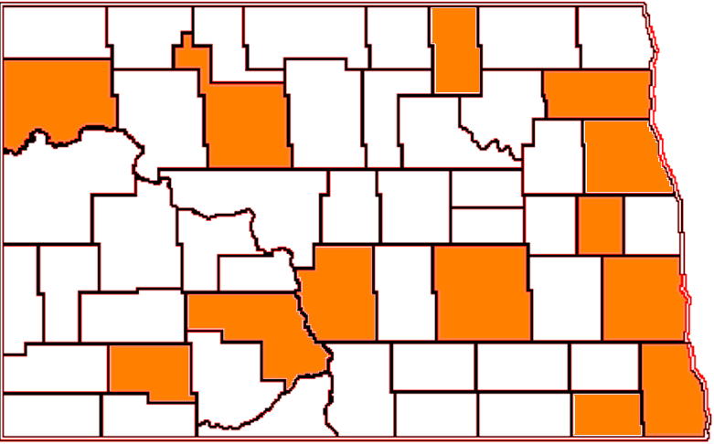
Home Rule Charters
Notes:
13 counties now have home rule charters, and in keeping with the spirit of the tool chest, their implementation has been quite varied. While most have rather broad ordinance authority to change levy limits, only a few have used this, about half have used their charter to change structure, and most have used it to implement a local sales tax.

Slide 13
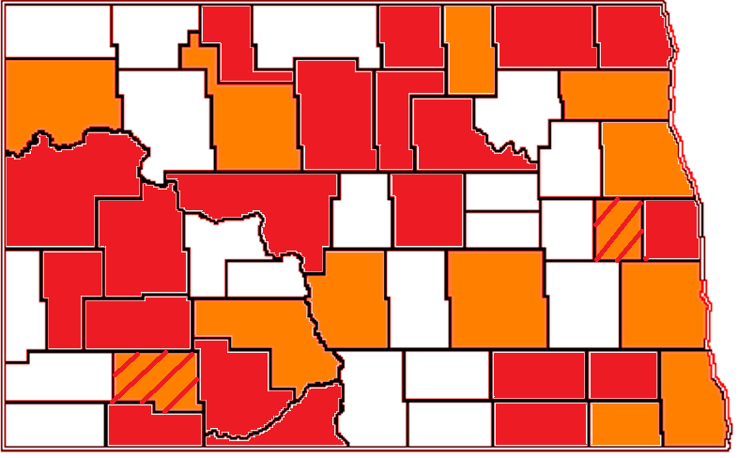
Home Rule Charters/11-10.2
Notes:
At least 24 counties have utilized the 11-10.2 provisions (2 of which subsequently adopted a home rule charter). Most have either combined elected offices, redesignated elected offices as appointed, or both. Although, several have used the provisions to separate the statutorily combined recorder/clerk and make the clerk elected. And I believe at least one county has combined and separated under two separate tool chest actions.
Again, this is the spirit of the preamble to the Tool Chest legislation; it is the “adaptation in local governance in recognition of the diverse circumstances and resources of North Dakota communities

Slide 14
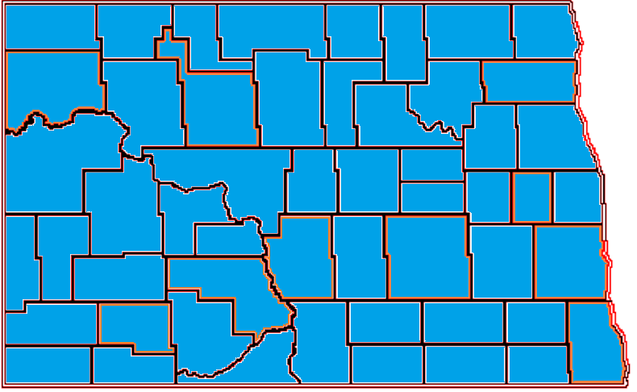
Joint Powers Agreements
Notes:
And because its easy, I made a map of all the counties that have in-place one or more joint powers agreements with other counties, cities, schools, part districts, tribes, and others. Its, as they say in the south “all you all”.

Slide 15
Tool Chest Impact
Notes:
So, What has been the result? While somewhat deceiving, looking at the “traditionally elected” offices of county government before the Tool Chest Legislation was passed, and those same offices now, you see that there are almost 100 fewer total “office holders” and almost 150 fewer elected officials. A “super county legislator” would be pleased. I say a bit deceiving, because, as those of you involved know, sometimes the addition of employees has been necessary- just removing the “elected status” doesn’t change the work that must be done – however it certainly provides significant administrative flexibility for county commissioners.

Slide 16
THANK YOU
Notes:
I just want to conclude by saying there are obviously lots of resources with your neighboring counties and the association has plenty of examples.

